Slide 1
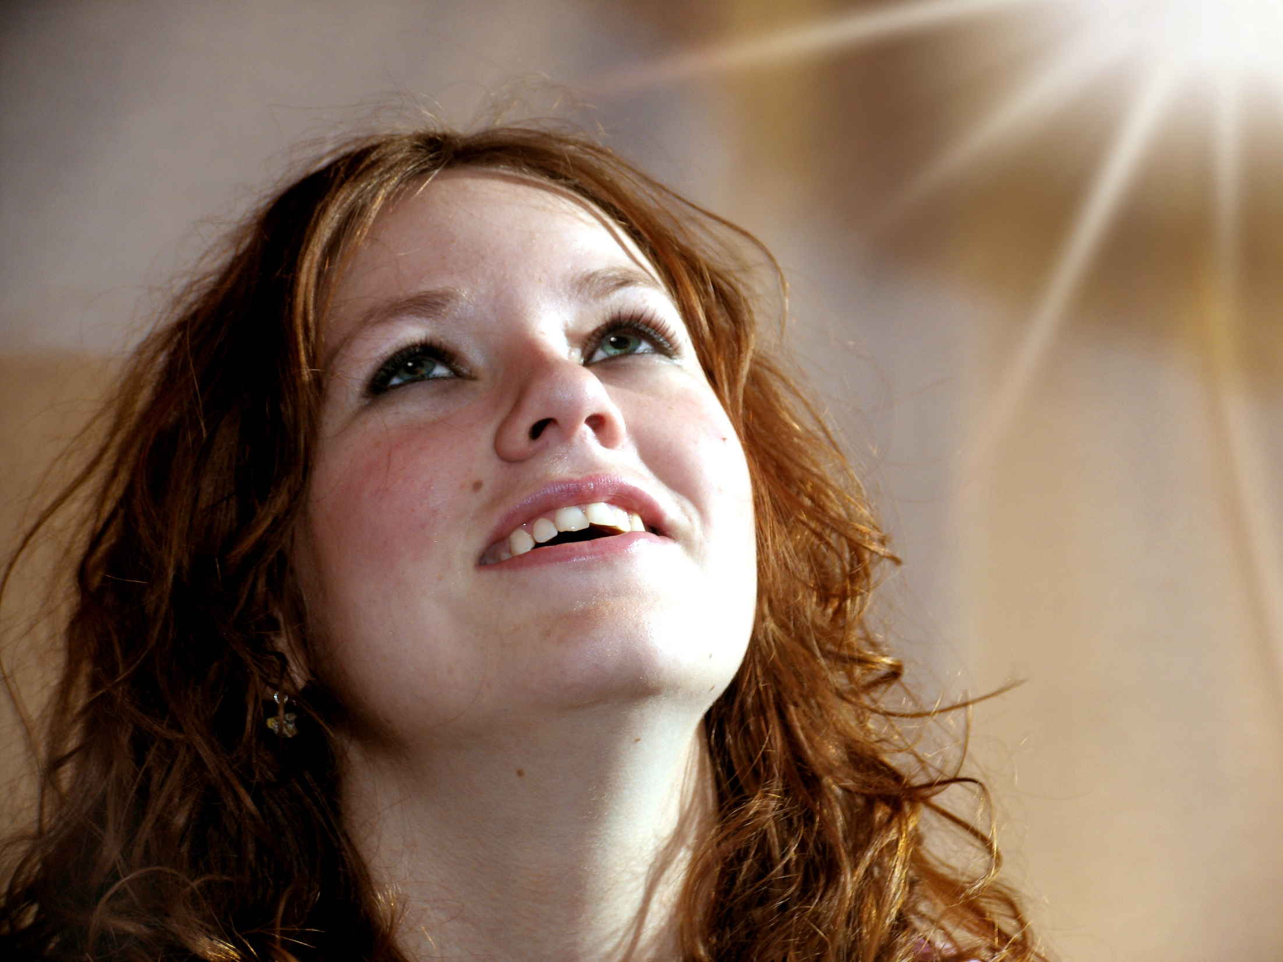
I know that my Redeemer Lives

Slide 2
‘I know that my Redeemer lives and that in the end he will stand upon the earth. And after my skin has been destroyed, yet in my flesh I will see God. I myself will see him with my own eyes.’ Job 19:25-27

Slide 3
Pictures Sweet Publishing / FreeBibleimages.org.

Slide 4
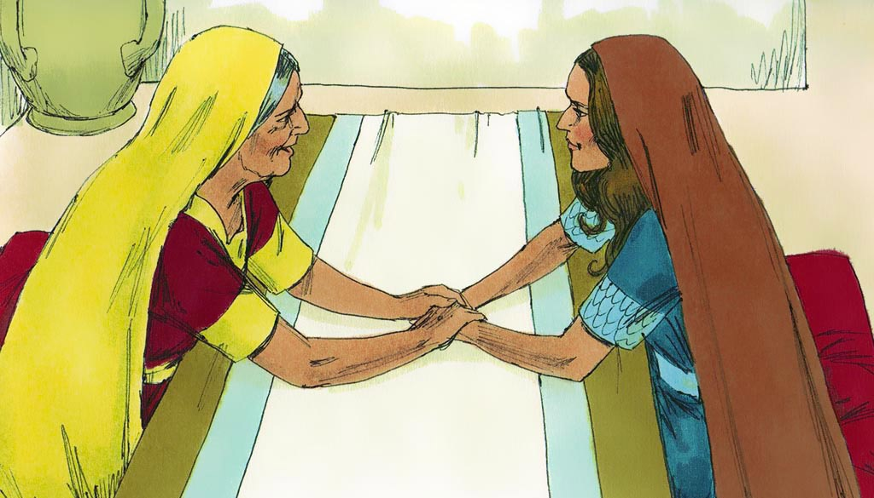
‘If one of your countrymen becomes poor and sells some of his property, his nearest relative is to come and redeem what his countryman has sold.’ Leviticus 25:25
Pictures Sweet Publishing / FreeBibleimages.org.

Slide 5
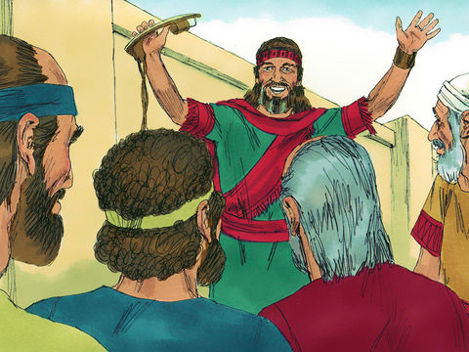
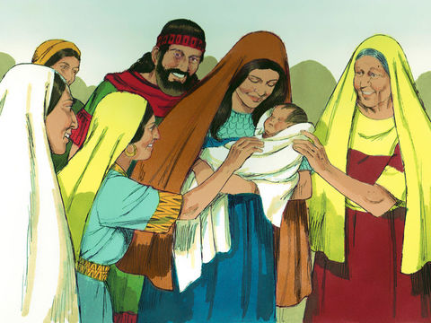
‘Salmon the father of Boaz, Boaz the father of Obed, Obed the father of Jesse, and Jesse the father of David’
Ruth 4:22
Pictures Sweet Publishing / FreeBibleimages.org.

Slide 6
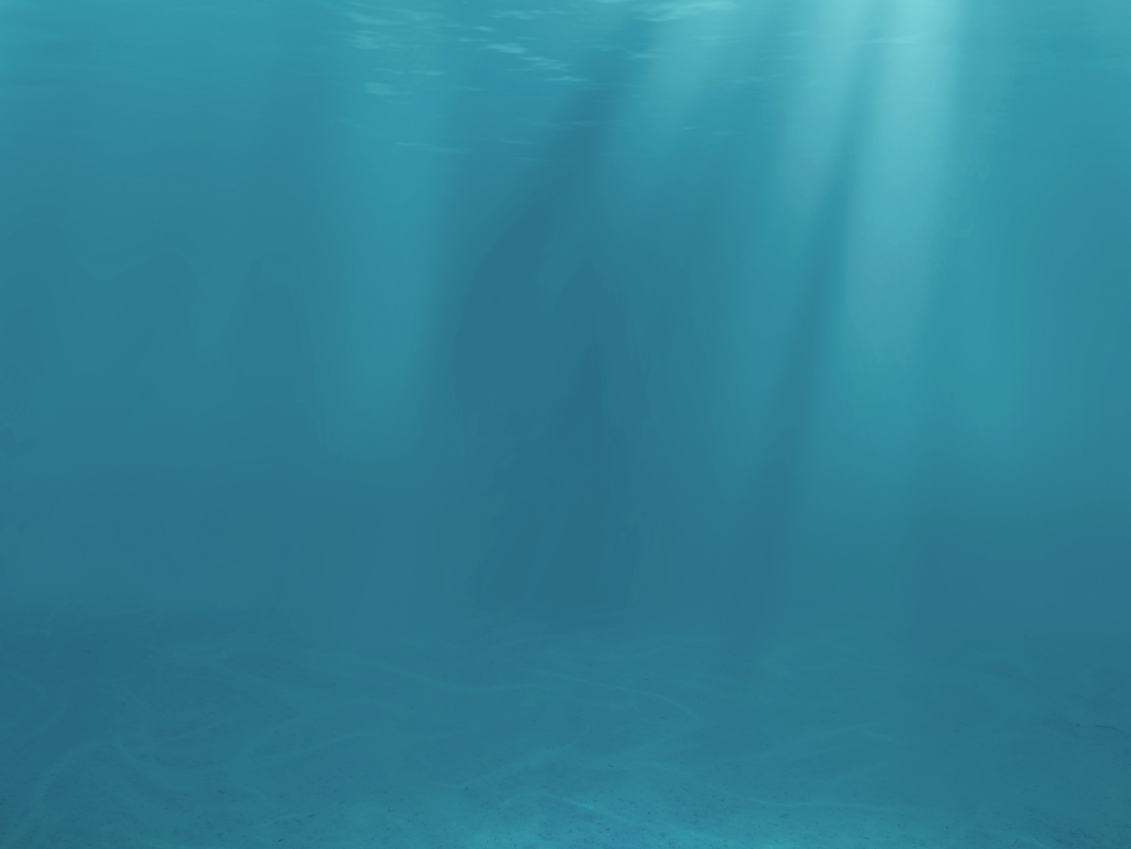
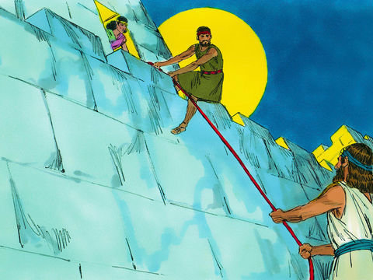
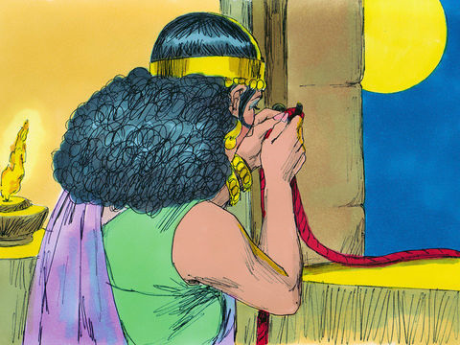
‘Salmon the father or Boaz, whose mother was Rahab’ Matthew 1:5
Pictures Sweet Publishing / FreeBibleimages.org.

Slide 7
Redemption

Slide 8
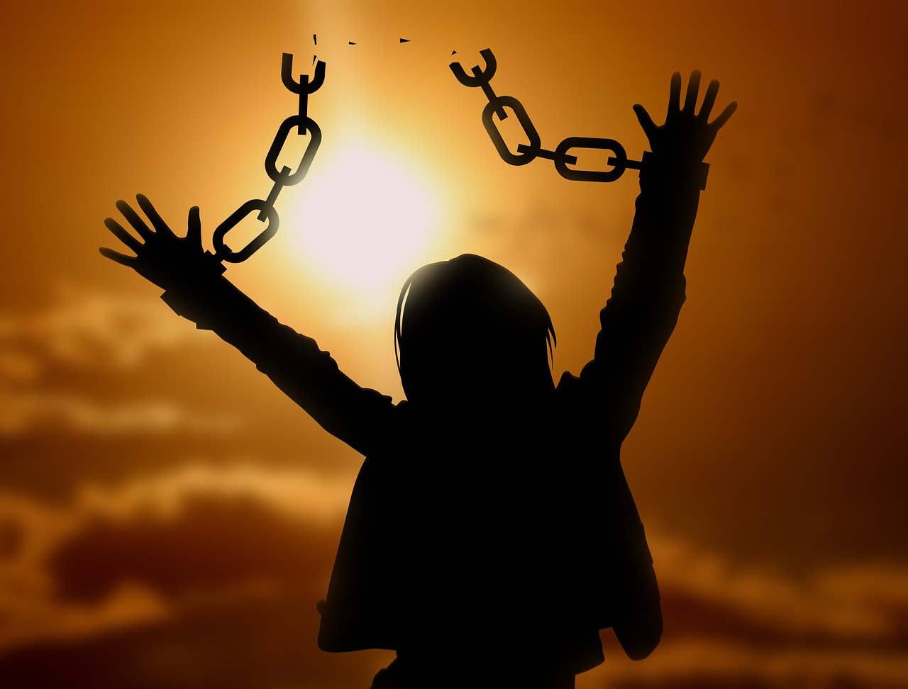
‘It is for freedom that Christ has set us free. Stand firm, then, and do not let yourselves be burdened again by a yoke of slavery’ Galatians 5:1

Slide 9
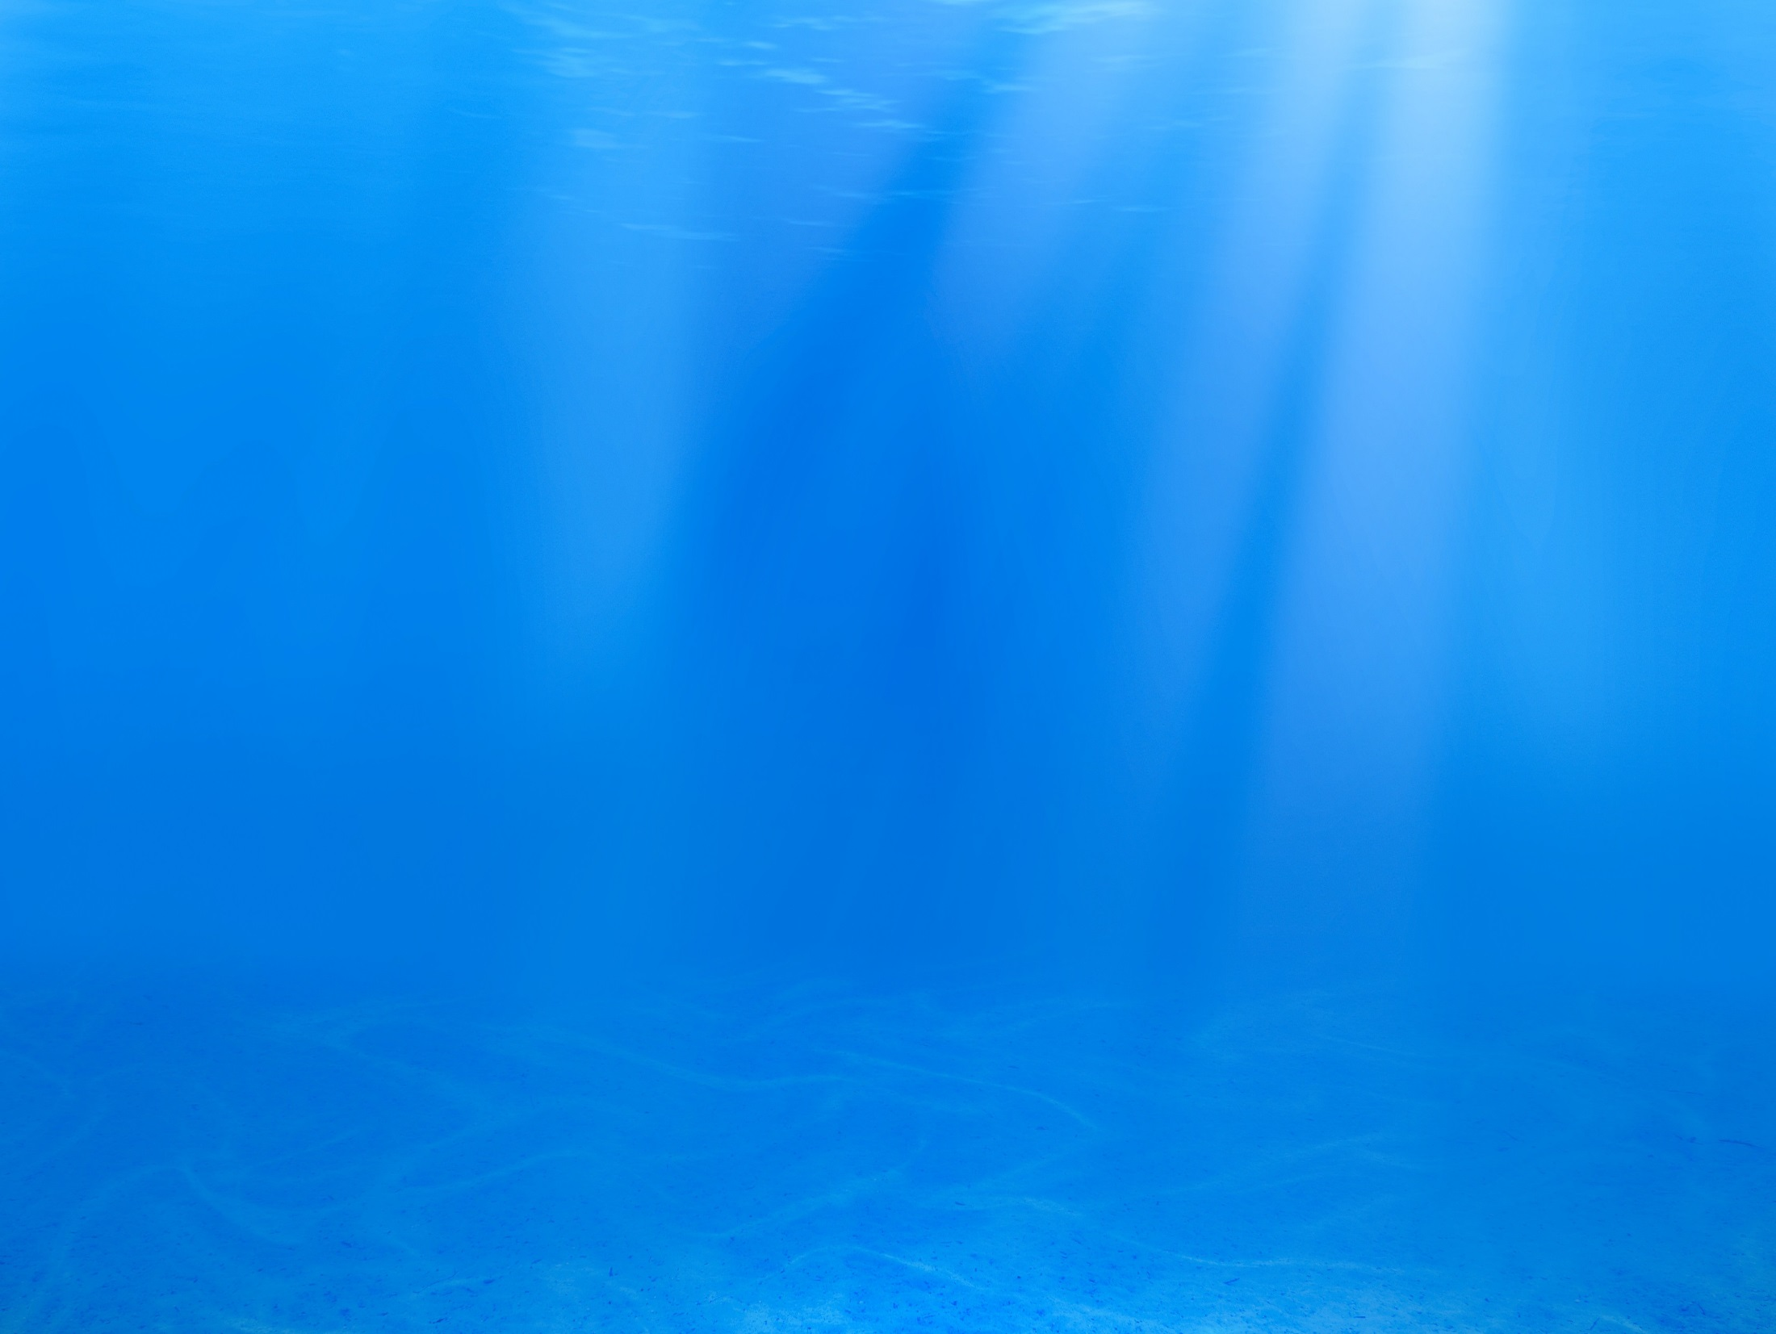
Isaiah 43:1-3
Fear not for I have redeemed you: I have summoned you by name; you are mine. When you pass through the waters I will be with you; and when you pass through the rivers they will not sweep over you. When you walk through the fire you will not be burned; the flames will not set you ablaze. For I am the LORD your God, the Holy One of Israel, your Saviour.

Slide 10
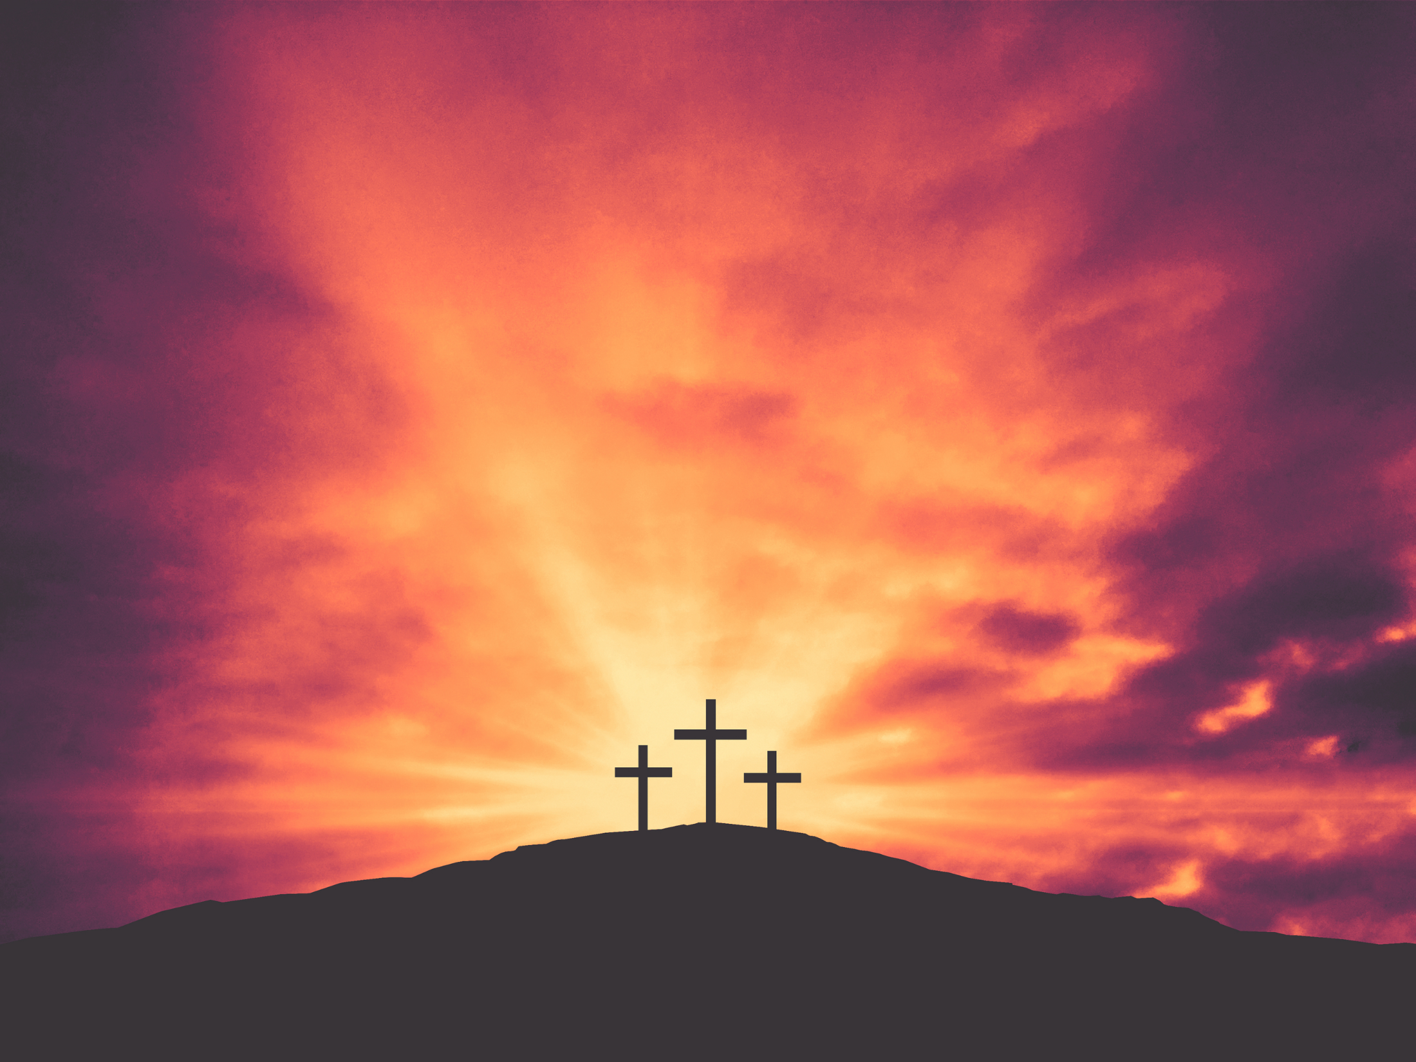
‘For you know that it was not with perishable things such as silver or gold that you were redeemed from the empty way of life handed down to you by your forefathers, but with the precious blood of Jesus Christ, a lamb without blemish or defect. He was chosen before the creation of the world.’
1 Peter 1:18-20

Slide 11
Inward implications
- Be thankful! - 1 Peter 1:18-20
- Let God take care of you - Isaiah 46:4
- Live free! - Galatians 5:1

Slide 12
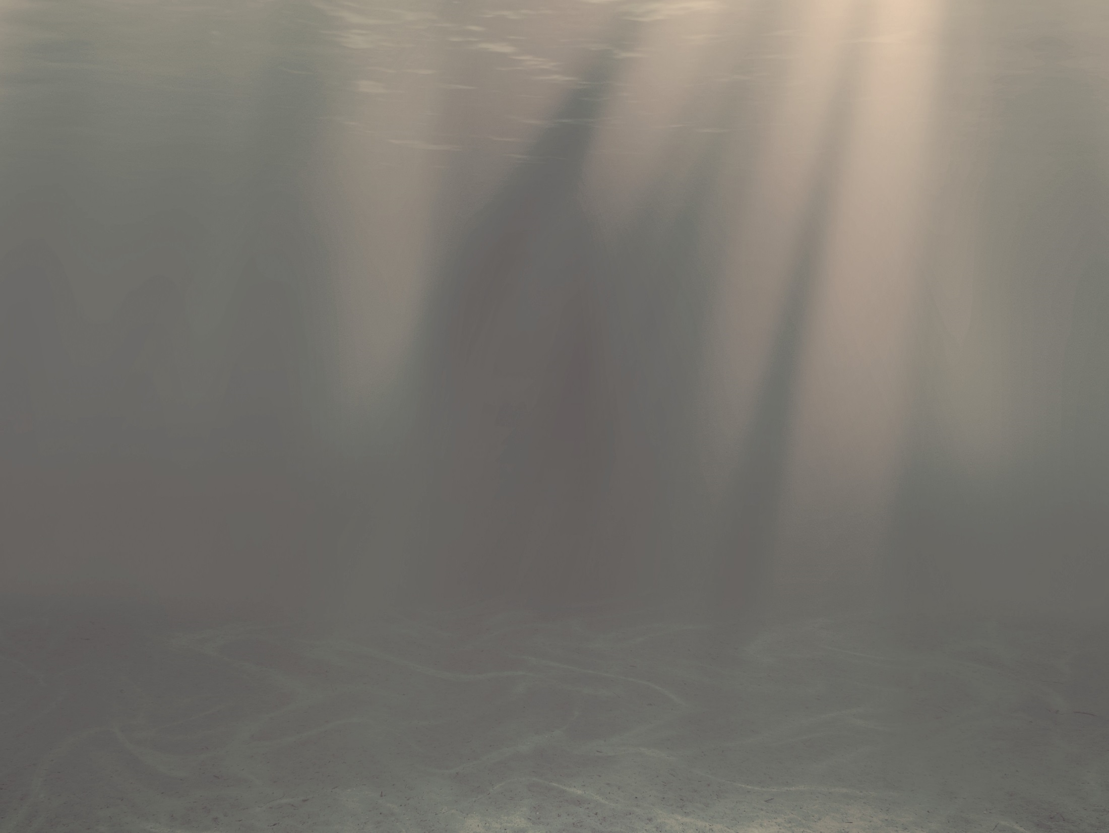
Outward implications Be like Boaz!
- Ask God to give you his heart for redemption
- Ask God to help us see people through his eyes
- Be willing to pay the price

Slide 13
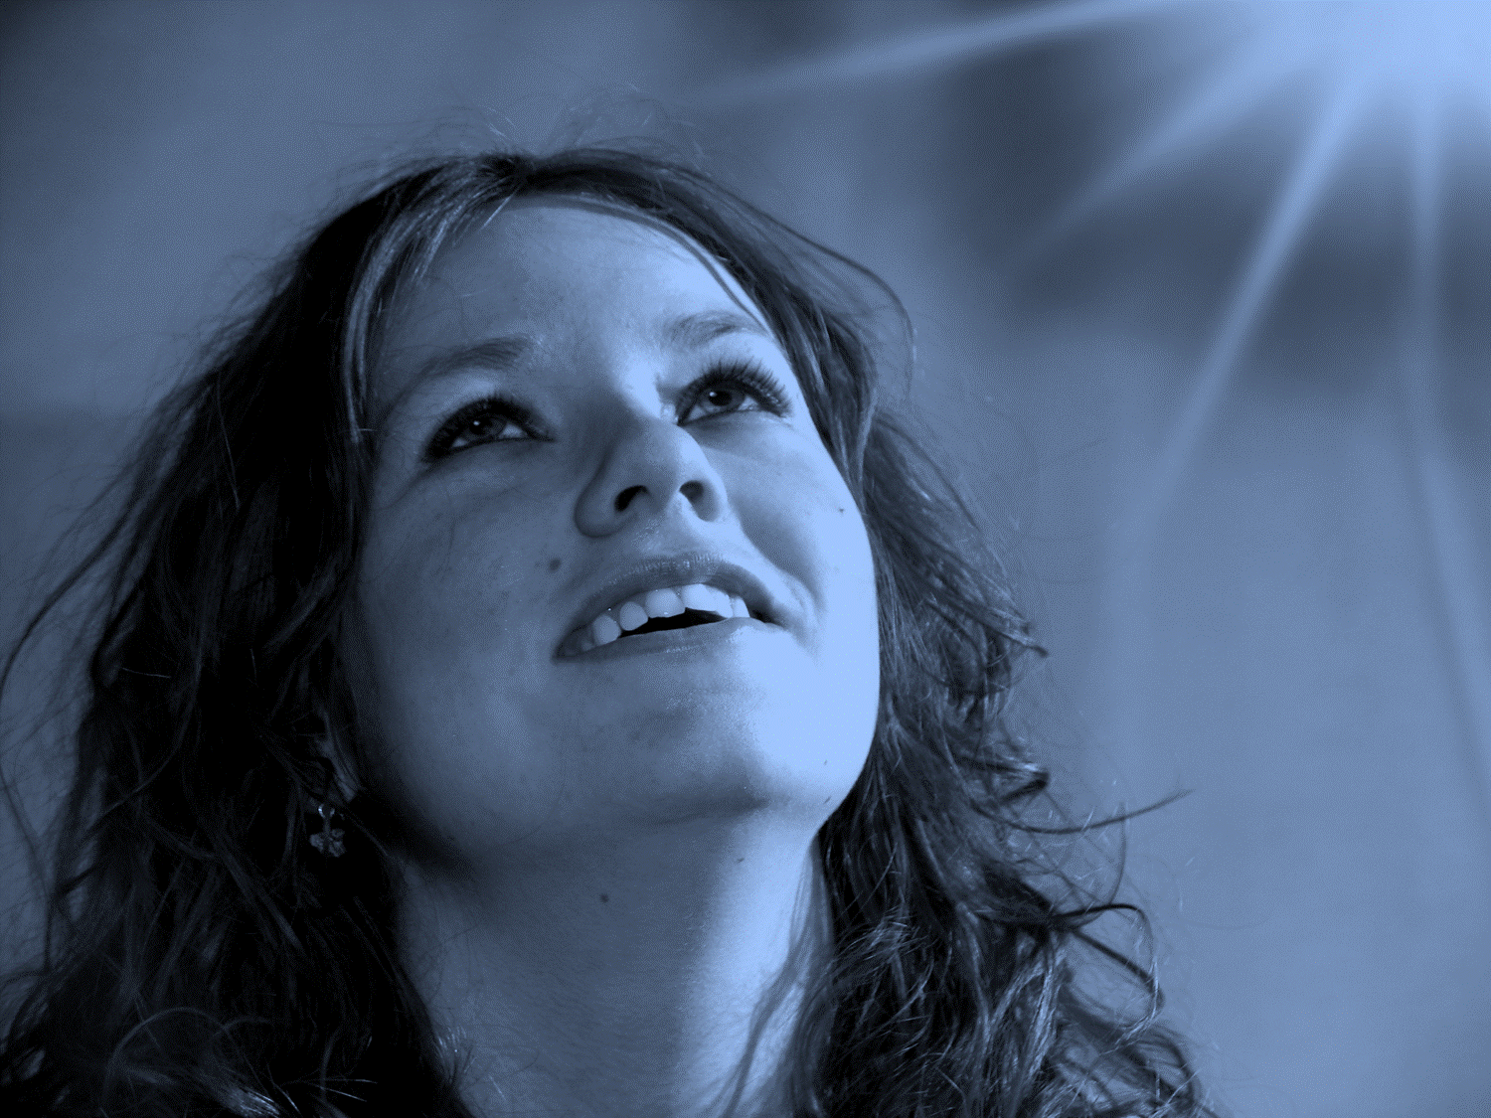
‘I know that my Redeemer lives and that in the end he will stand upon the earth. And after my skin has been destroyed, yet in my flesh I will see God. I myself will see him with my own eyes.’ Job 19:25-27

