Slide 1
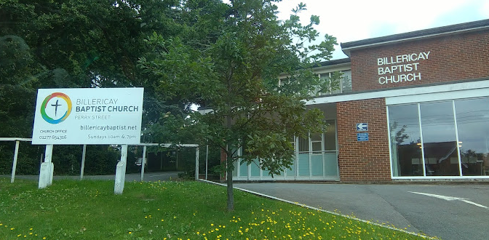
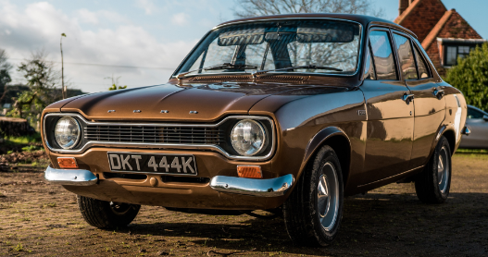

Slide 2
The church opens wide her doors

Slide 3
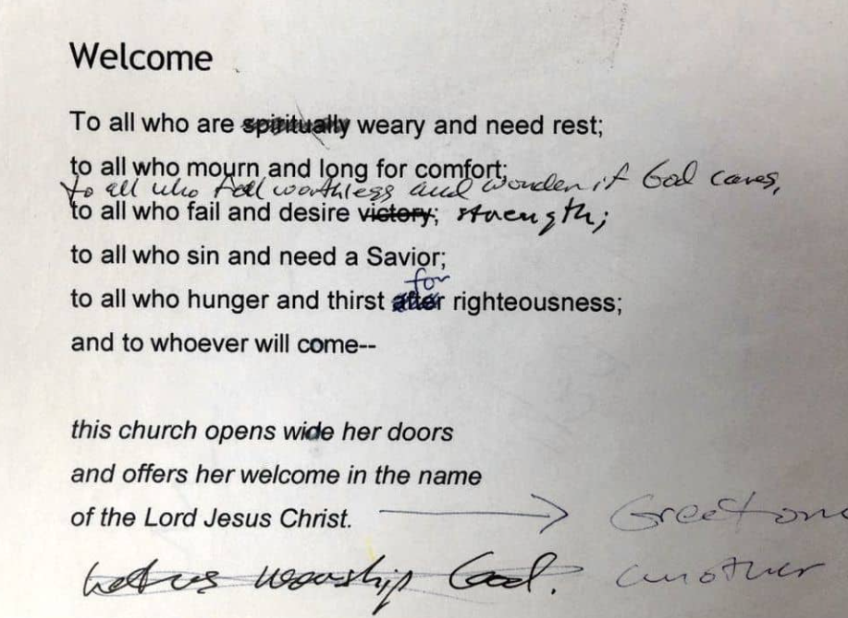
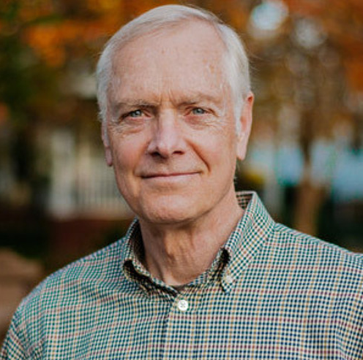
Welcome liturgy
Ray Ortlund
Adapted from James Boice from Tenth Presbyterian Church

Slide 4
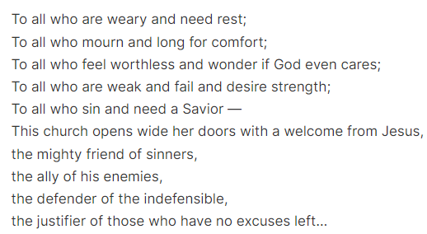
Welcome liturgy
“I just want people to know, it’s going to be different now. You just walked into grace. We can relax. We can own up. We can be honest. We can face the living God through the blood of Christ and let him speak to us.”

Slide 5
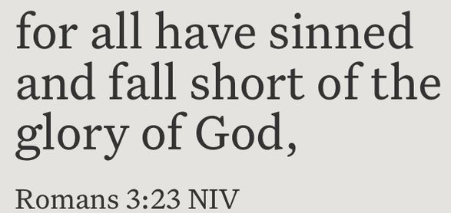

Slide 6
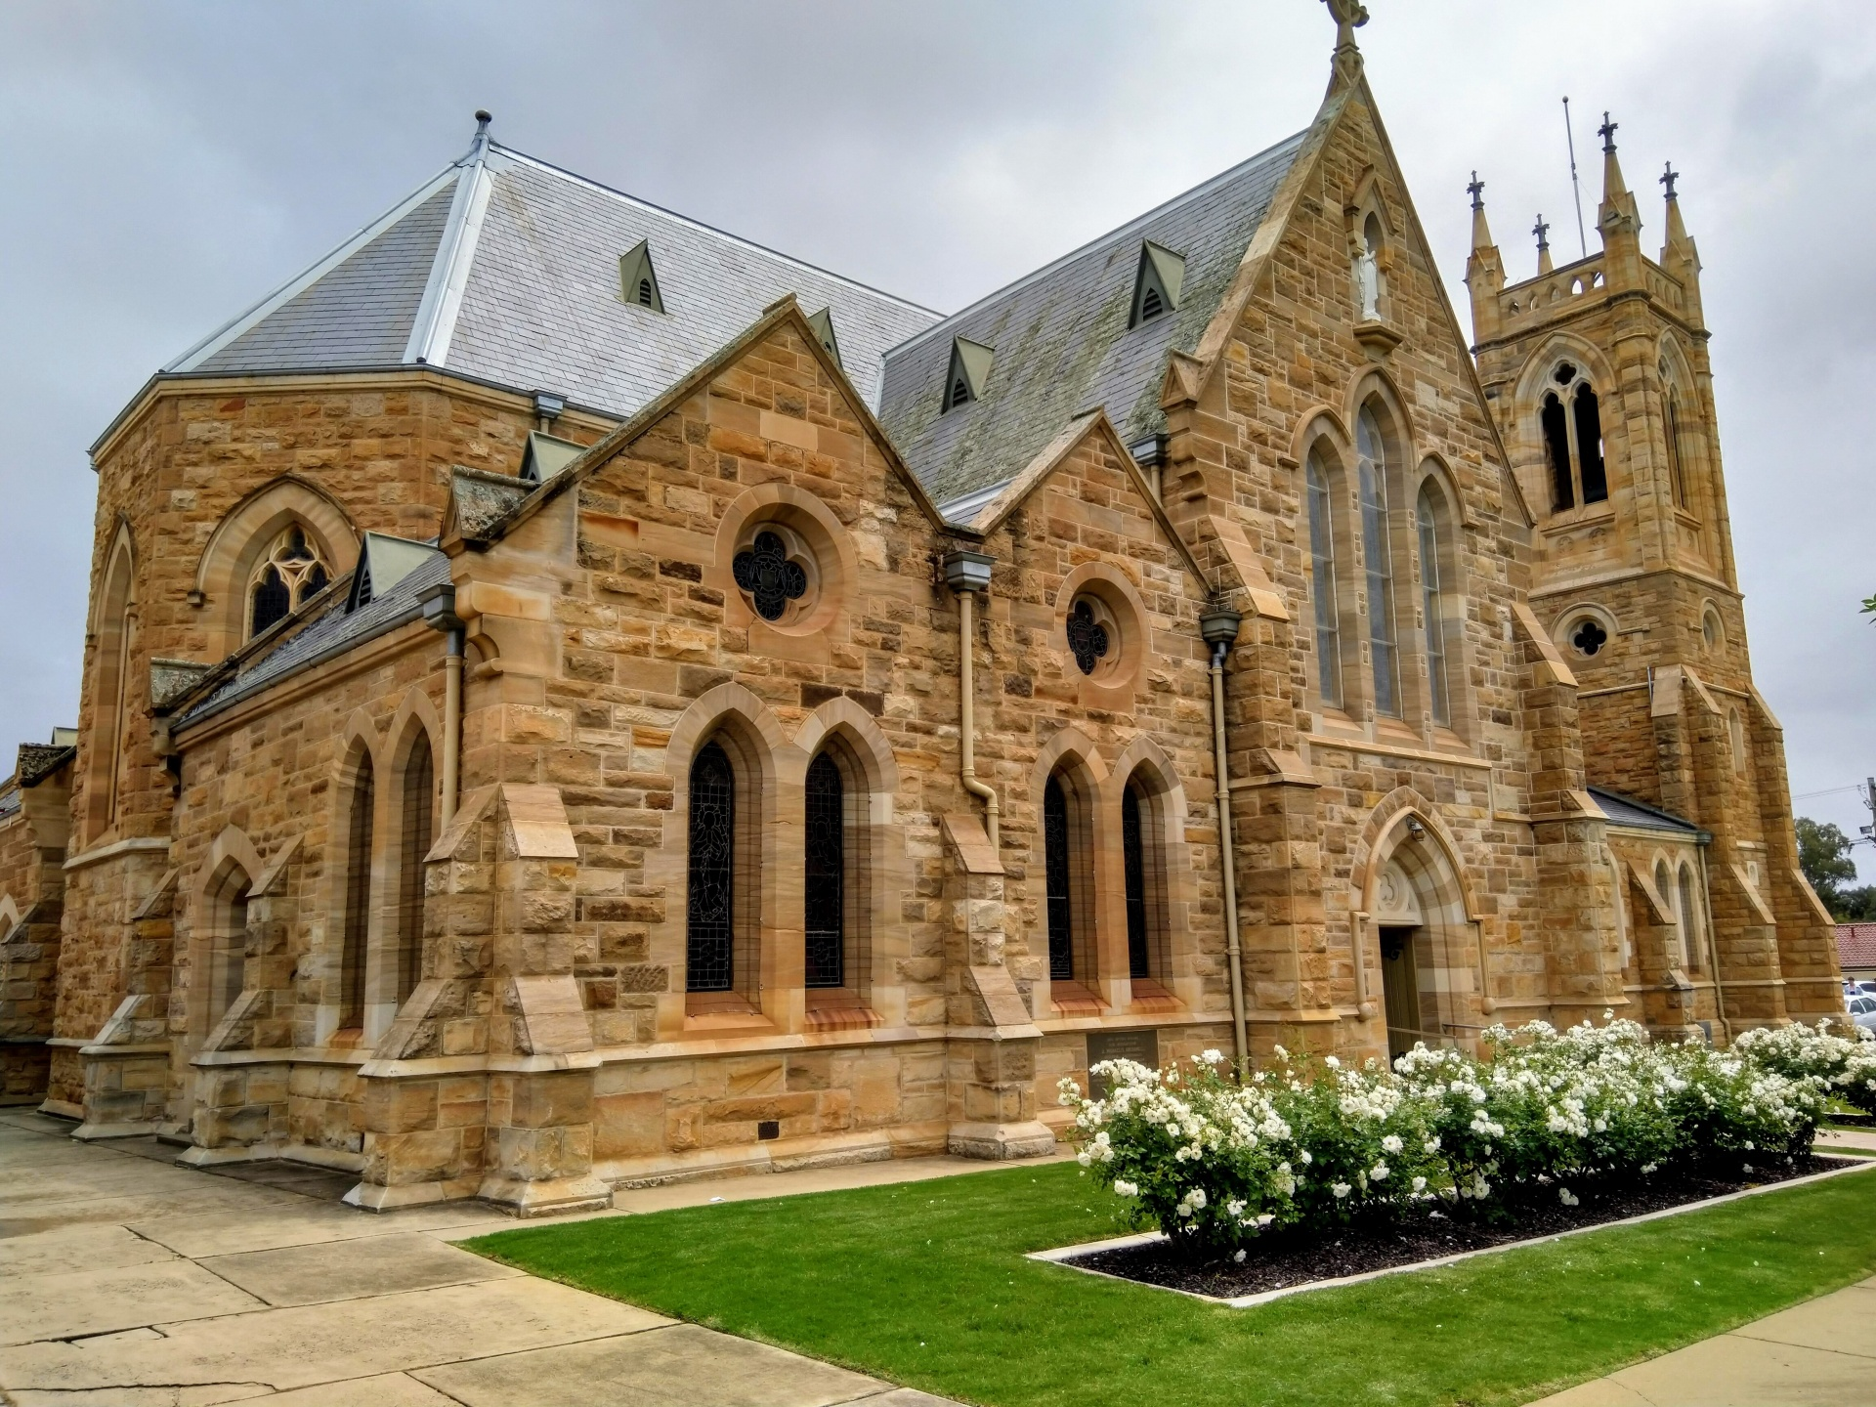
80% of practising Christians have a positive view of the church
21% of non-Christians have a positive view of the church

Slide 7
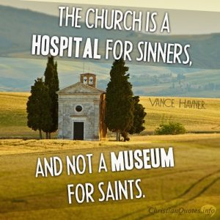
Luke 19:10
“For the Son of Man came to seek and save the lost.” NIV

Slide 8
The mission of Jesus…
…is OUR mission!

Slide 9
What’s our driving force?

Slide 10
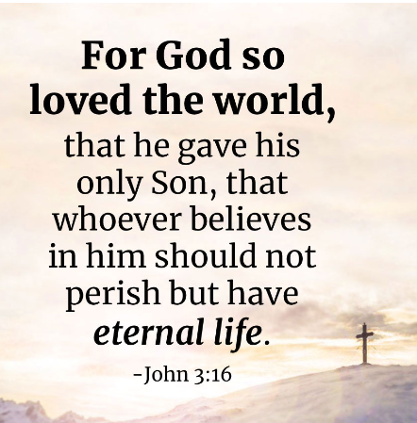

Slide 12
What can we do to open our doors wider?
Ask some of our non-believing friends what they think of Christian churches in our community.
Think what it’s like to enter a new church – what contributed to our impression that the people were welcoming?
Can we get involved in our own neighbourhood or community? (School events, for example)
Can we take church outside the walls – prayer walking for example?

