Slide 1
Create in me a pure heart..
..reflections on Psalm 51

Slide 2
“The Psalms express a kaleidoscope of feelings about life and faith in our relationship with the Lord. For example they contain feelings of faith, depression, doubt, loss, hope, joy, penitence, praise, thanksgiving and worship. They can help us to express our deepest emotions in our relationship with the Lord.”

Slide 3
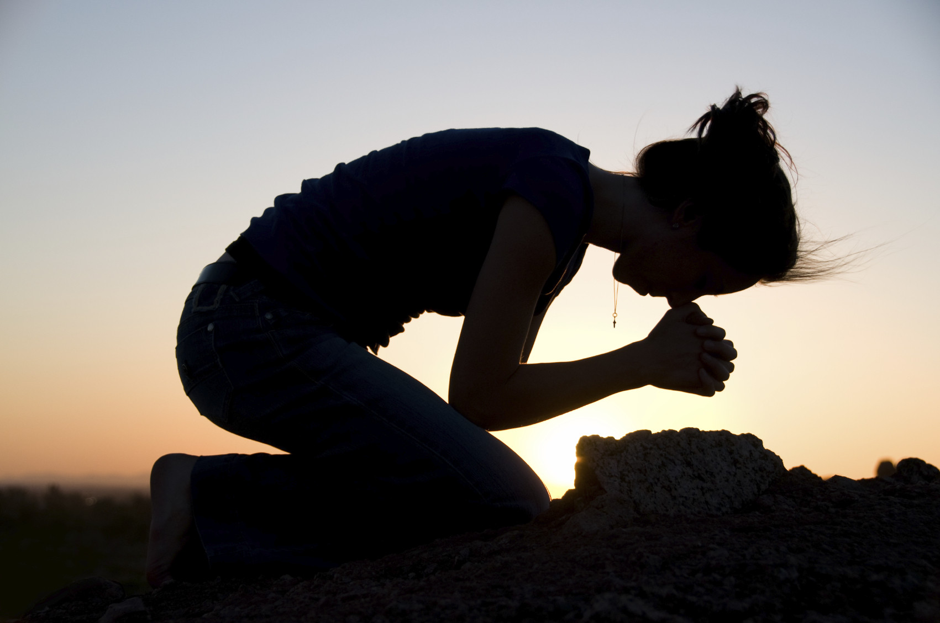

Slide 4
Psalm 51
¹⁷ My sacrifice, O God, is a broken spirit; a broken and contrite heart you, God, will not despise.
¹² Restore to me the joy of your salvation and grant me a willing spirit, to sustain me.
¹⁰ Create in me a pure heart, O God, and renew a steadfast spirit within me.

Slide 5
Psalm 51
¹⁷ My sacrifice, O God, is a broken spirit; a broken and contrite heart you, God, will not despise.

Slide 7
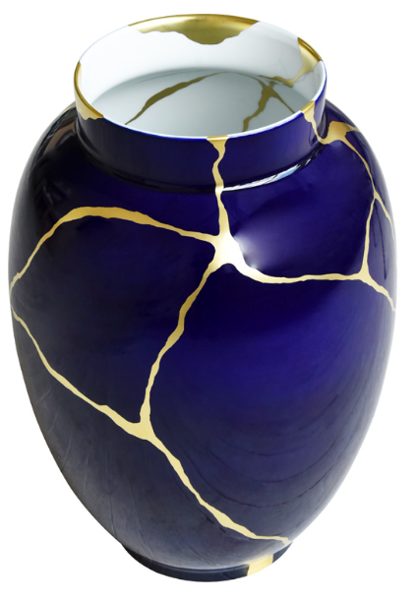
Kintsugi
Golden repair

Slide 8
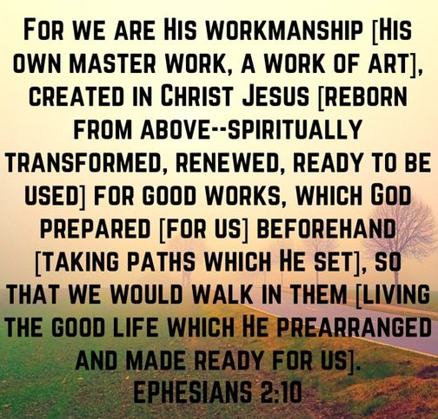

Slide 9
Psalm 51
¹² Restore to me the joy of your salvation and grant me a willing spirit, to sustain me.

Slide 11
Psalm 51
¹⁰ Create in me a pure heart, O God, and renew a steadfast spirit within me.

Slide 12
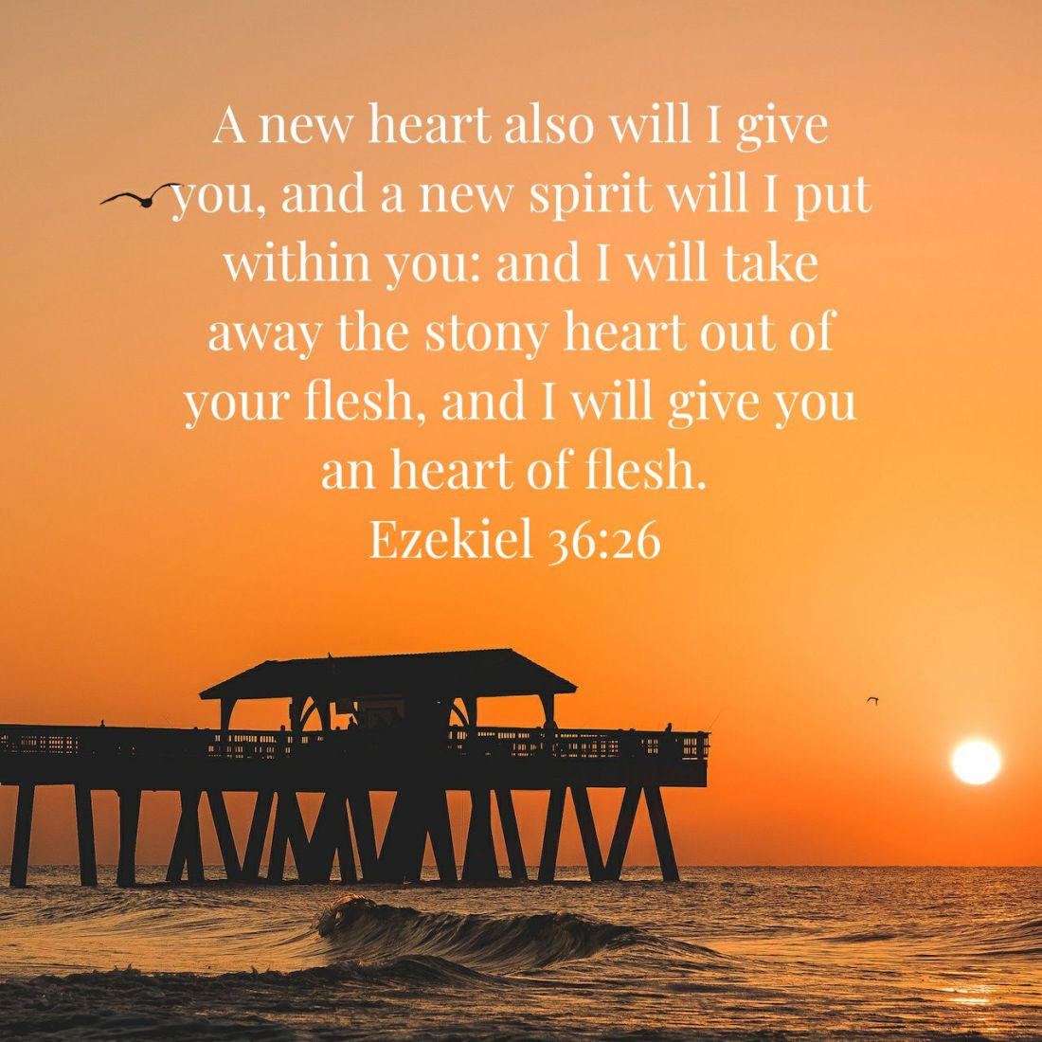

Slide 13
How can we be part of the “new” thing?
By coming humbly before God with a “broken” spirit and repenting.Psalm 51 verse 17
By living day by day with a “willing” spirit, reading His word,worshipping Him and listening to the Holy Spirit. Psalm 51 verse 12
By believing that God can create in us a pure heart and renew a “steadfast” spirit .Psalm 51 verse 10

